Slide 1
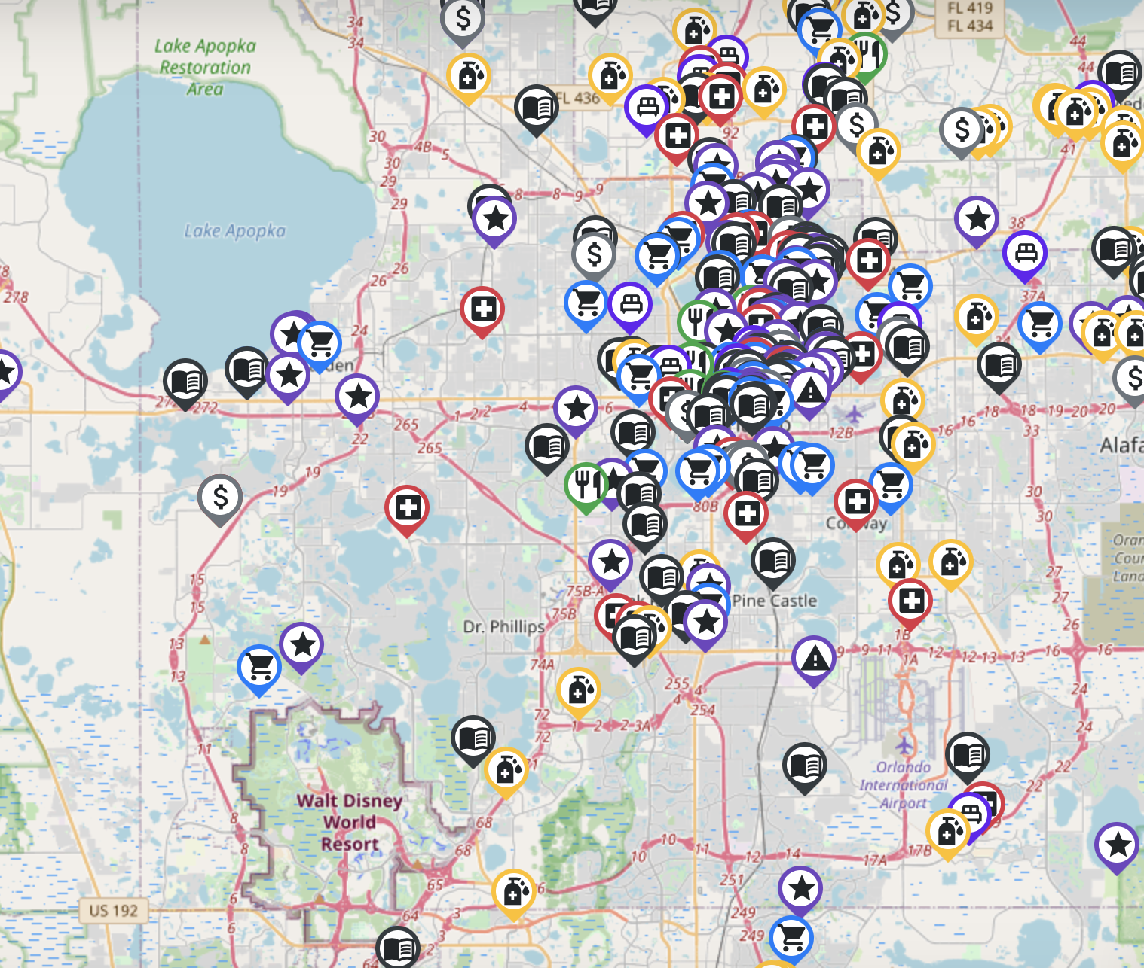
Welcome to Florida Community Innovation!

Slide 2






Tech We Use

Slide 3
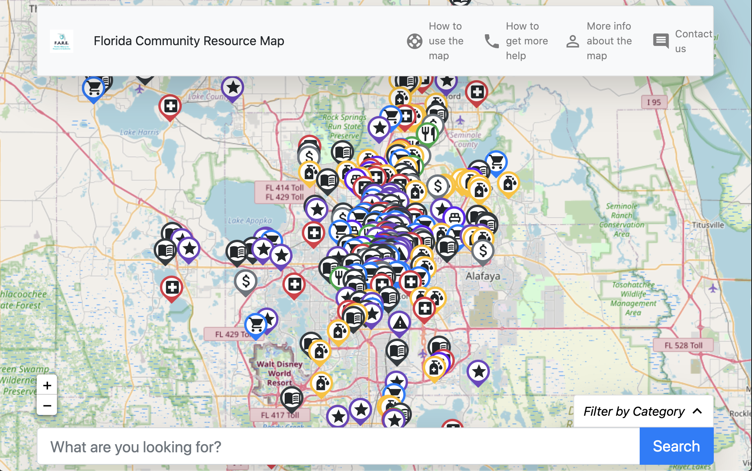
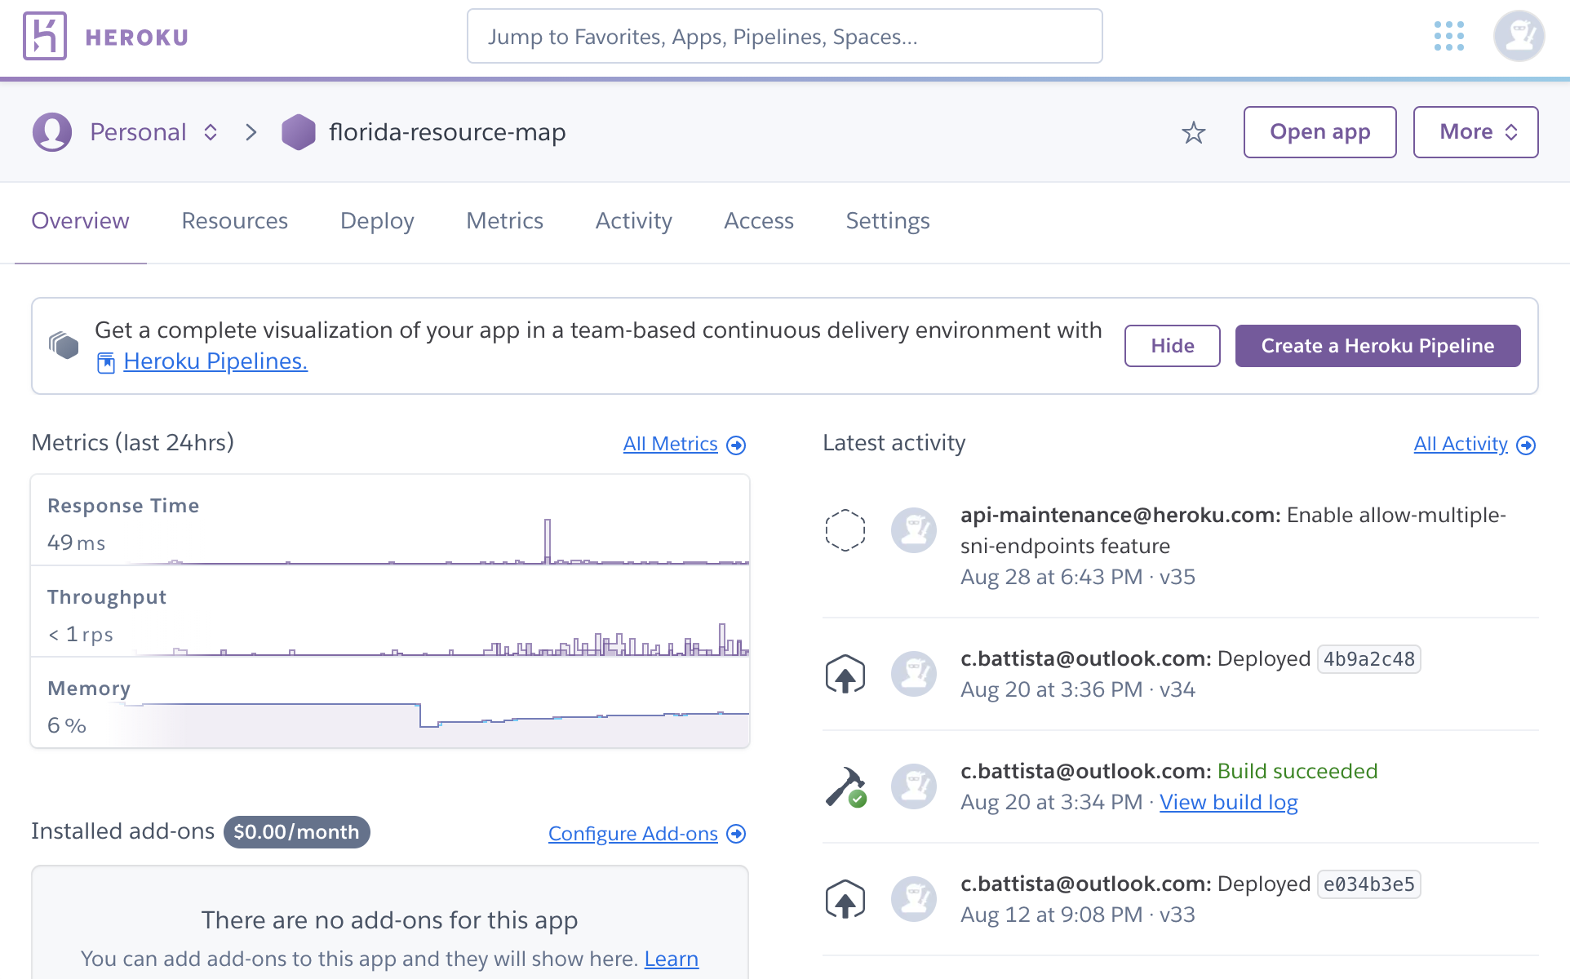
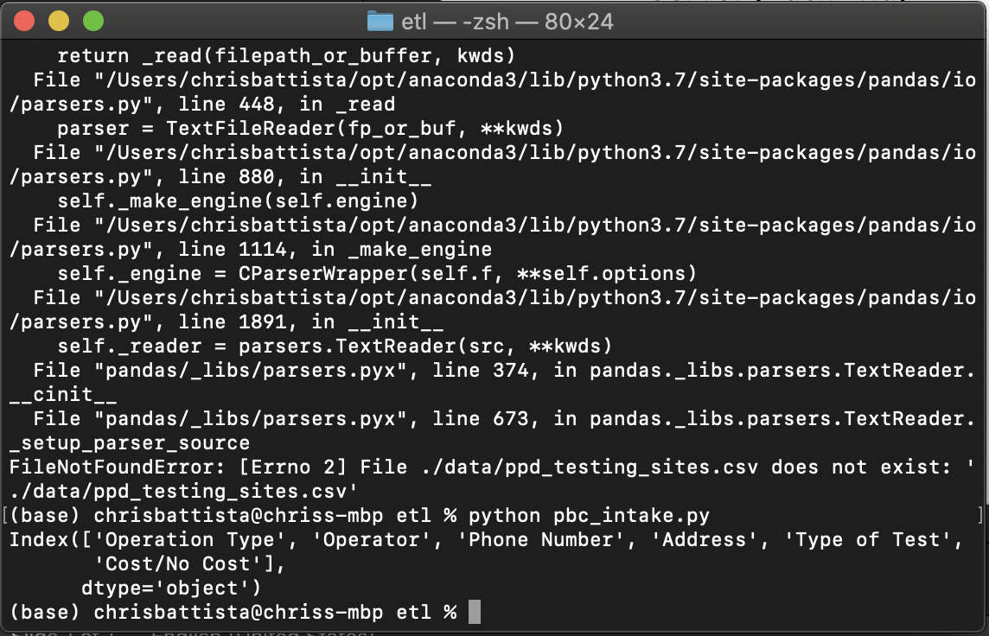
Current Tech Stack
Client (Front End)
React + Bootstrap front end UI
mrt.json
NodeJS server
Server (Back End)
Heroku cloud virtual machine
Backend Python data pipeline (local; manual)
Data Pipeline (Back End)
Git

Slide 4
Future Tech Stack
= upgraded or new
Client (Front End)
Upgraded React + Bootstrap front end UI
Proper API
NodeJS server
Server (Back End)
Cloud virtual machine
Data Pipeline (Back End + Front End)
Web-based intake form
Cloud data pipeline
Git

